Slide 1

Communities

Slide 2
Fahrenheit Co.
James W. Garrett
Database Establishment
Database Requests
Christopher Bednarz
Backend App Connectivity
Eric Anderson
Front End
Back End
Mason Holley
Map Display
Geolocation API
Zoe Chamlee
Server Creation/Maintenance
DevOps
Rishabh Tewari
Front End Fixes
Back End Fixes

Slide 3
What is Communities?
1
A Brief Review

Slide 4
Reminder of our Project
Massive Connectivity Online
Distant relationships
Local Area Community App
Use our app for News, Posts and Events
Limited Scope

Slide 5
Objectives
Create an application to connect with people within the local scene.
Diversify from similar platforms by filtering visibility to a user’s location.
Encourage participation in local communities via local events
Allow any user to start a group and recruit others within the local scene.
Create tools to maintain and moderate that community.
Cultivate healthy user-base through continuous app growth.

Slide 6
Specifications
Database: MariaDB
Server Storage: 25 GB
Hosting Service: Linode
Hosting Service Expense: $5/month
Web Framework: Revel
Frontend Development: HTML
API: Nominatim and Leaflet

Slide 7
Functionality
Provide account creation and tools, including a membership system
Provide community creation and management tools
Individual community message boards
Ad and premium memberships for monetization purposes
Filters for relevant communities based on search parameters and location
Community event scheduler to communicate to all users in a community

Slide 8
Standards and Safety
ISO-Standard Password Encryption
All sensitive data such as passwords and geolocation data are encrypted
GDPR-Get permission to keep info and will not sell it
The app needs to use sensitive data so we maintain user anonymity while using the app’s location features
ANSI - Working to generally improve public health through the app
Fostering in person interaction between communities

Slide 9
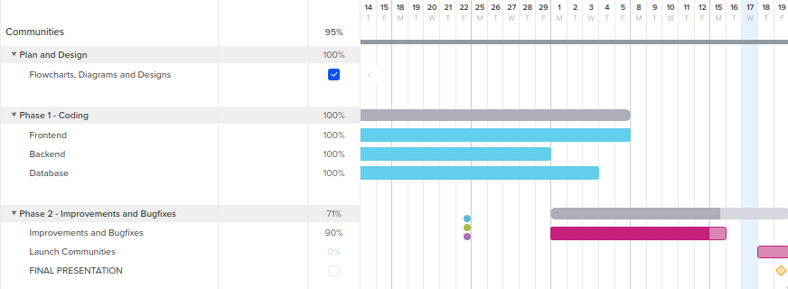
Gantt Chart

Slide 10
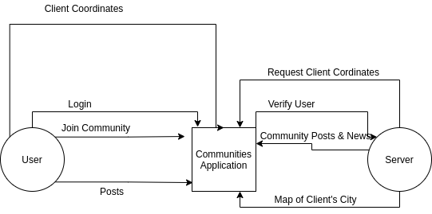
Level 1 Diagram

Slide 11
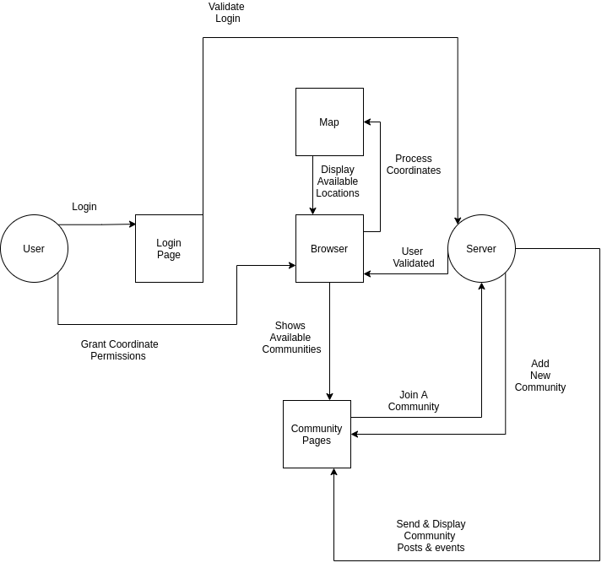
Level 2 Diagram

Slide 12
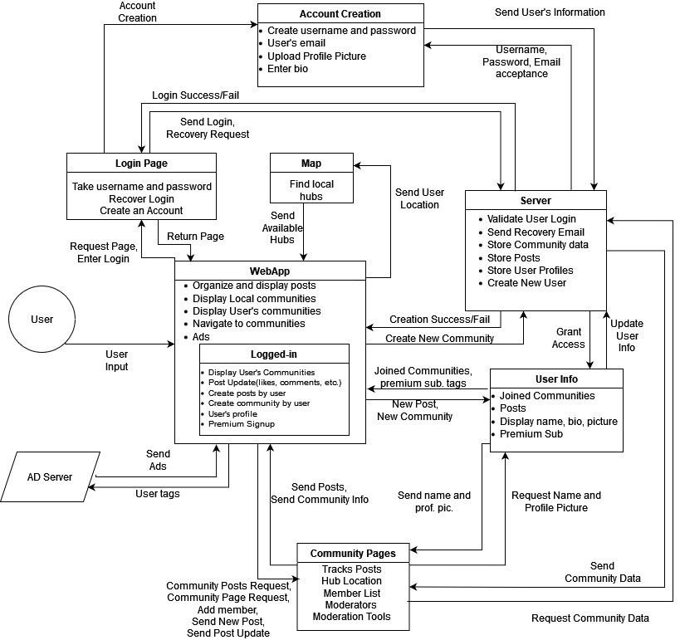
Level 3 Diagram

Slide 13
Communities Code
2
Error Handling and Snippets

Slide 14
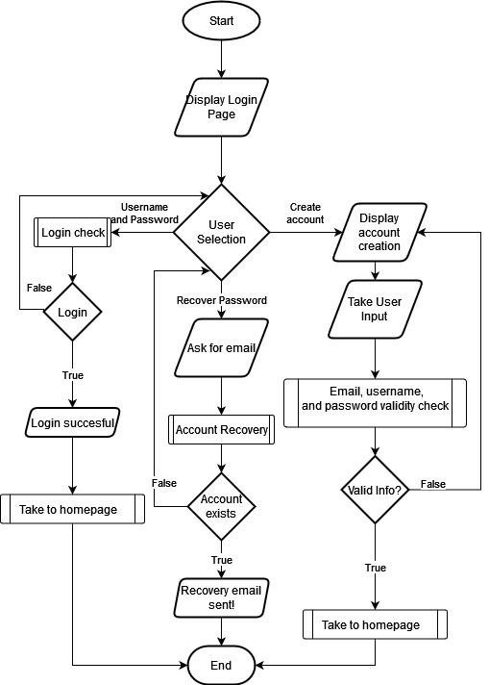
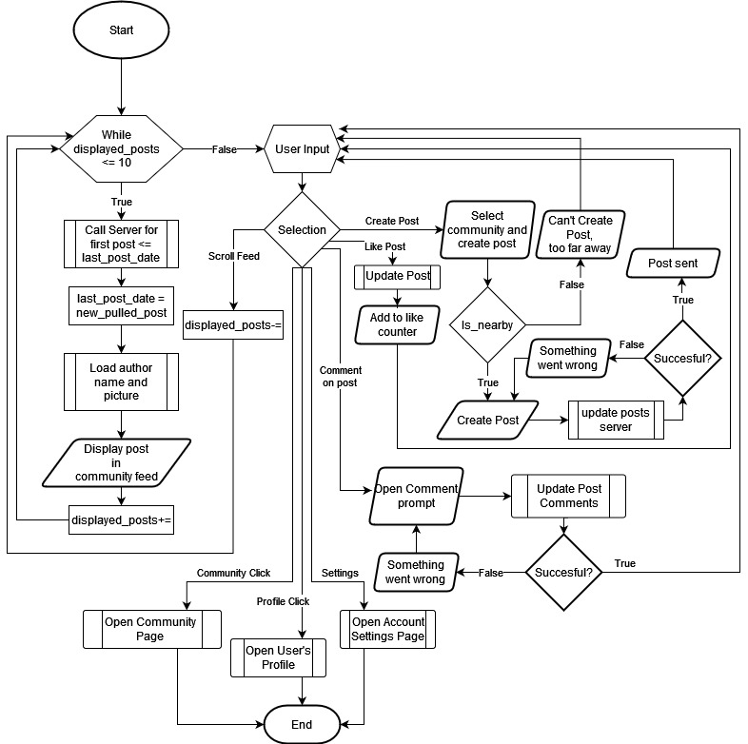
Error Handling Flowcharts

Slide 15
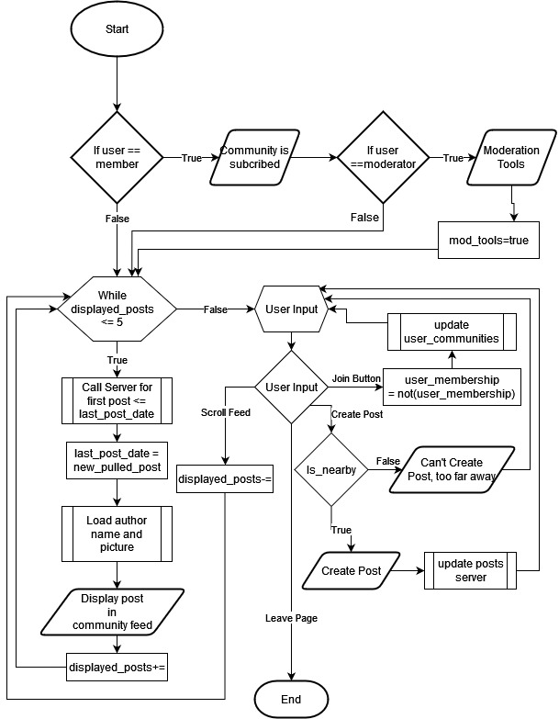
Error Handling Flowcharts

Slide 16
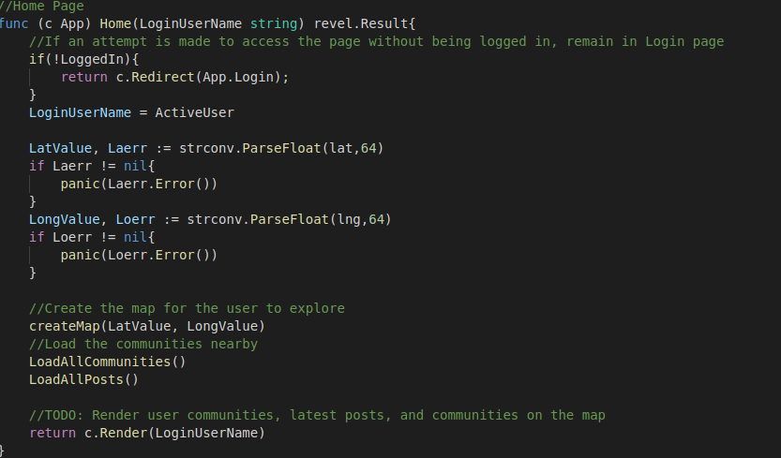
Code Blocks - Backend

Slide 17
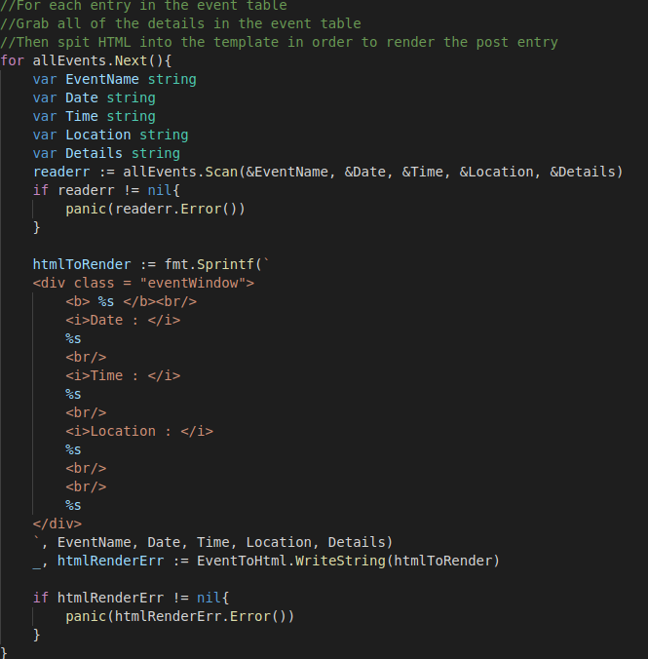
Code Blocks - Backend

Slide 18
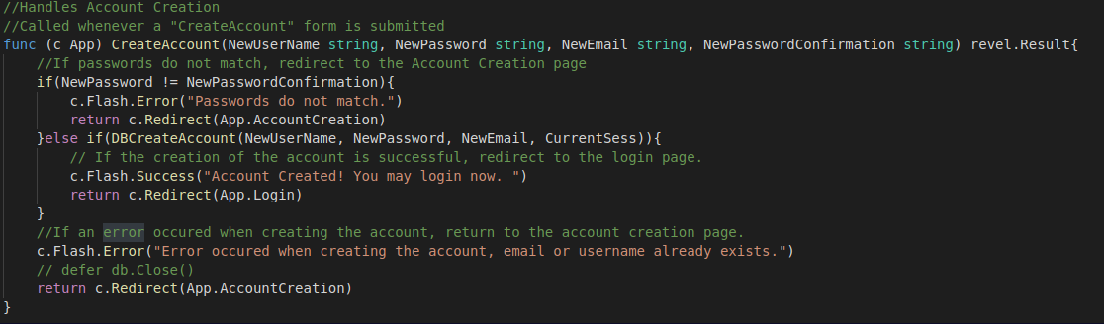
Code Blocks - Backend

Slide 19
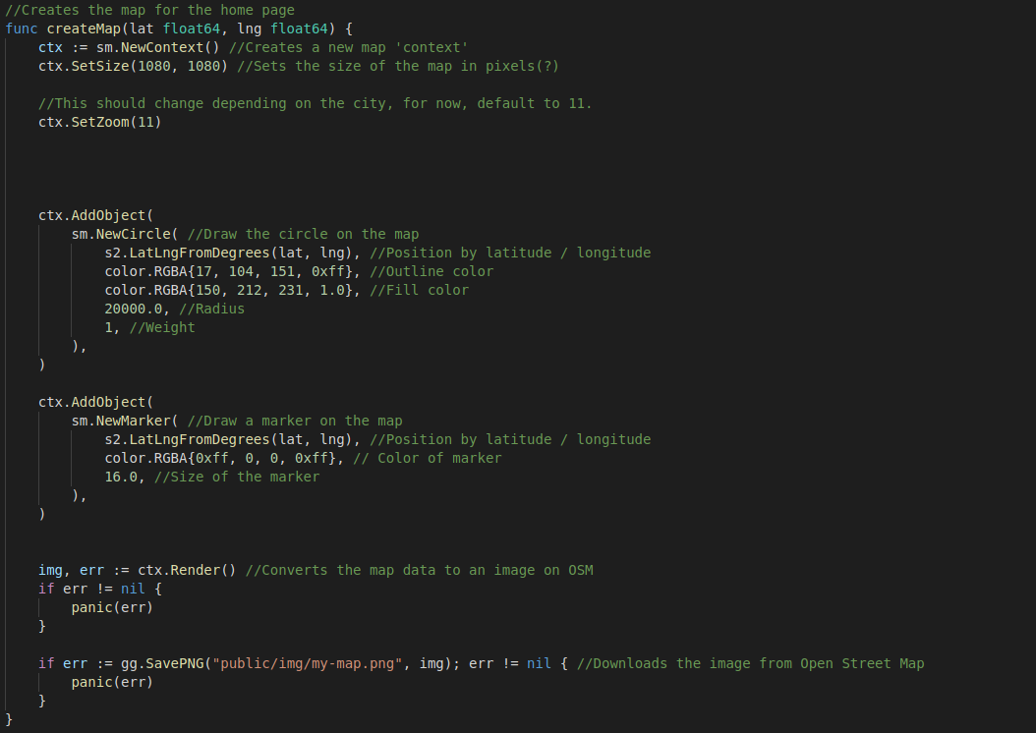
Code Blocks - Map

Slide 20
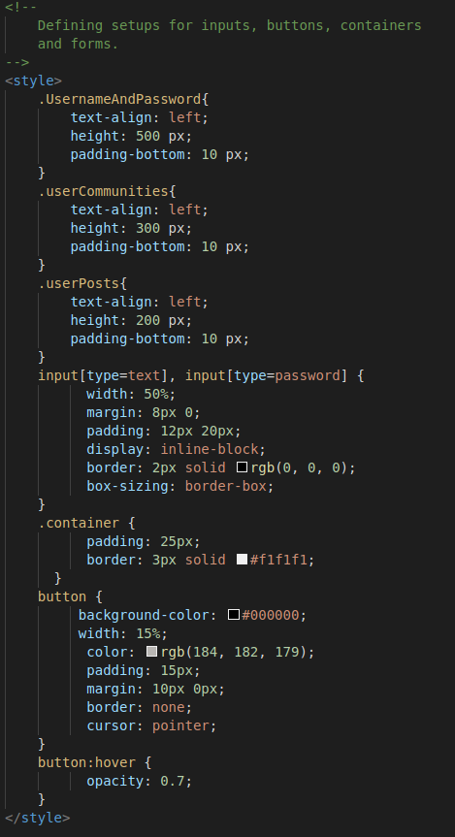
Code Blocks - Frontend

Slide 21
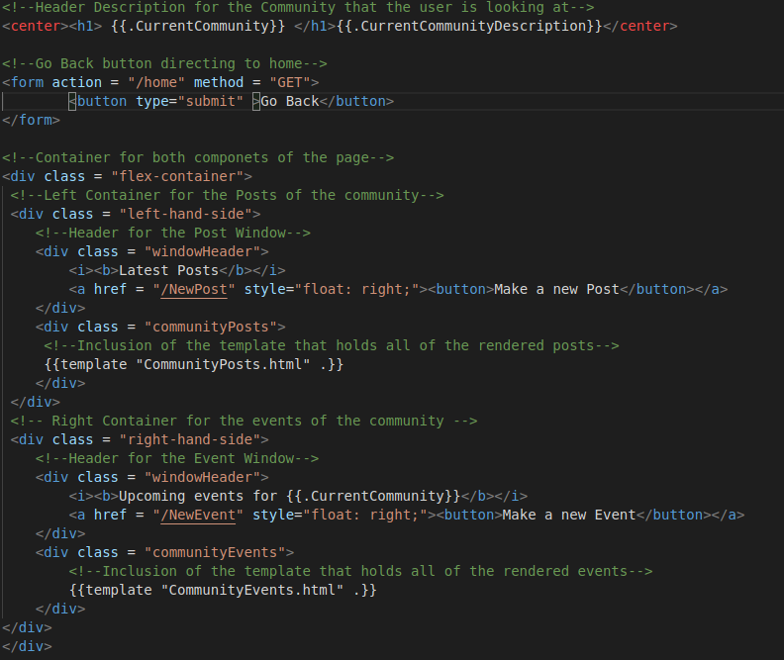
Code Blocks - Frontend

Slide 22


Version Control

Slide 23
Project Demonstration
The software in motion

Slide 24
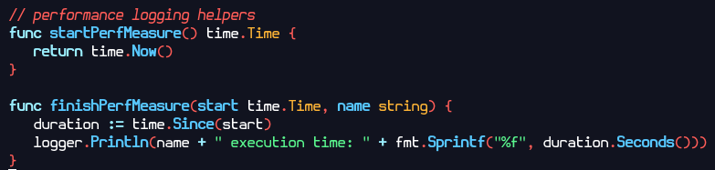
Performance Metrics

Slide 25
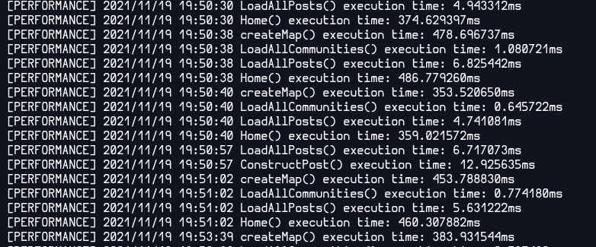
Performance Metrics
LoadAllPosts() | 6ms | LoadAll Communities() | 0.8ms
LogValidate() | 575ms | constructPost() | 13ms
Home() | 396ms | createMap() | 383ms

Slide 26
Conclusions
Future Plans
Provide ease connecting with others with similar interests by providing them a platform.
Encourage participation in local communities through events and our map
Our project should revolutionize the social media field
If we continued, further features and quality of life would be added
Effective teamwork and planning deadlines
Understanding on task assignment and completion

